Slide 1
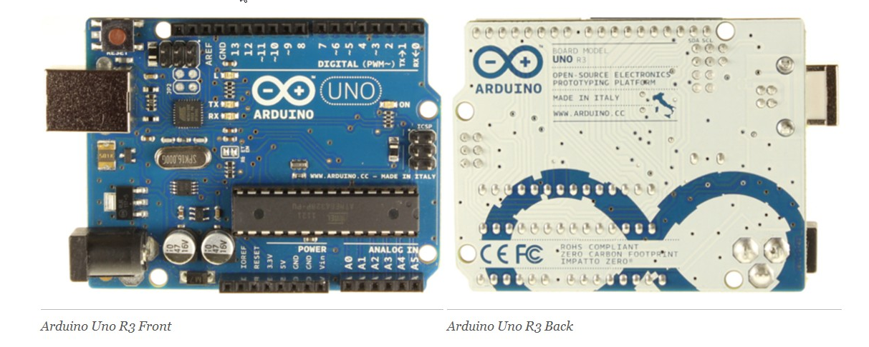
Hardware Basics
Arduino
Robotics Week Instructor
Joy Shetler, PhD
Intel Ultimate Engineering Experience (IUEE)
Notes:
This is the Arduino UNO board which we are using for the projects during Robotics week. There are many other versions of the Arduino. We are using an R3 board (3rd generation).

Slide 2


Overview
“He who would learn to fly one day must first learn to stand and walk and run and climb and dance; one cannot fly into flying.” - Friedrich Nietzsche
Microcontrollers
Arduino Board
myQuad Kit
Power
Digital and Analog
Shields
Summary
along with a couple of Projects!
Notes:
Here’s a basic outline of this presentation. There will also be some “lab” work. You will get to try out some simple functions using the Arduino board.

Slide 3

Robotics
Robotics is the branch of technology that deals with the design, construction, operation, structural disposition, manufacture and application of robots [1] and computer systems for their control, sensory feedback, and information processing.
A modern passenger airliner is essentially a flying robot, with two humans to manage it. The autopilot can control the plane for each stage of the journey, including takeoff, normal flight, and even landing
The mechanical structure of a robot must be controlled to perform tasks.
How to “control” the robot is the focus of Robotics week.
Notes:
Here’s a basic outline of this presentation. There will also be some “lab” work. You will get to try out some simple functions using the Arduino board.

Slide 4
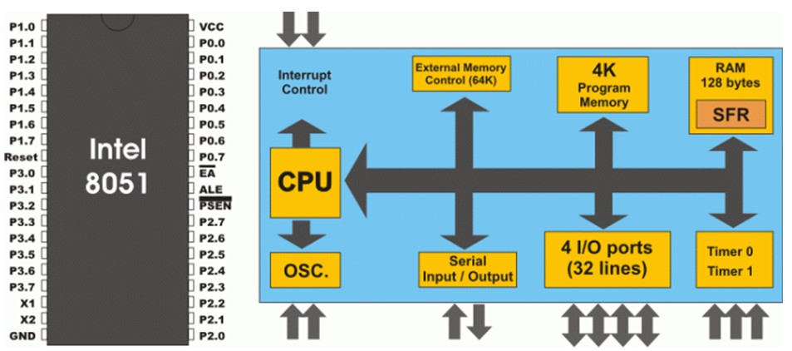
Microcontrollers
A single chip that contains the processor (the CPU), non-volatile memory for the program (ROM or flash), volatile memory for input and output (RAM), a clock and an I/O control unit.
Microcontrollers are programmable, cheap, small, can handle abuse, require almost zero power, and there are so many varieties to suit every need.
They are tiny affordable computers that you can put right onto your robot.
Notes:
Microcontrollers have been manufactured for quite a long time. An example is an Intel chip. The Intel 8051 was introduced in 1980.
Intel provided all the needed initial tools and support with the 8051 - assembler, application notes, example software, in-circuit emulator. The basic datasheet set is still THE reference source of information on 8051 and its derivatives. While Intel no longer provides the 8051 as a chip, many versions still exist, the 8051 has been licensed to various manufacturers worldwide.

Slide 5
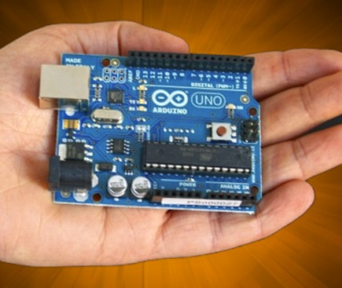
Arduino Microcontroller
Arduino is a popular open-source single-board microcontroller, …designed to make the process of using electronics in multidisciplinary projects more accessible.
The Arduino can be controlled from your computer or programmed and then disconnected and allowed to work independently.
The Arduino can be powered through a USB connection to your computer or a separate battery or AC adapter.
The Arduino board has a number of connection sockets that can be wired up to external electronics, such as motors, relays, light sensors, laser diodes, loudspeakers, microphones, etc.
Notes:
For low-cost hobbyists, there are a number of very cheap, simple to learn microcontrollers being developed. The Arduino is very inexpensive and was developed in Italy. One is being advertised on Amazon for $20.99 (June 2012).
The Raspberry Pi is also quite inexpensive and was developed in the UK. It is an ARM based hardware platform, with GNU/Linux software. The Rasberry is selling for about $25.00 (or more depending upon the distributor or seller).

Slide 6
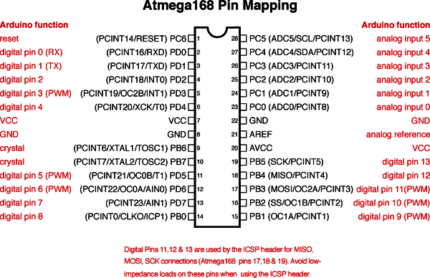
Arduino Microcontroller
The ATmega328 processor on the Arduino board has 32 KB of memory (with 0.5 KB used for the bootloader). It also has 2 KB of SRAM and 1 KB of EEPROM (which can be read and written with the EEPROM library).
Notes:
The ATmega 168/328 pinout is show here. The 168 and 328 have the same pin mapping. The pins on the chip (in black) are “mapped” to the Arduino board pins (shown in red).

Slide 7
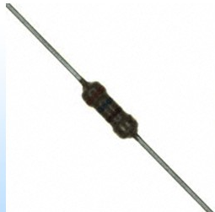
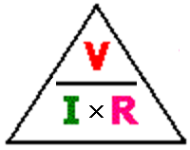
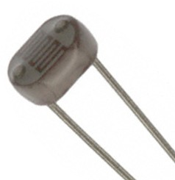
myQuad Kit - Resistors
myQuad Kit contains a couple of resistors that we will use with the Arduino.
Resistor -resistor is a passive two-terminal electrical device that implements electrical resistance as a circuit element.
The current through a resistor is in direct proportion to the voltage across the resistor’s terminals.
The ratio of the voltage applied across a resistor’s terminals to the intensity of current through the circuit is called resistance.
This is represented by: Ohm’s Law
LDR - A photoresistor or light dependent resistor is a resistor whose resistance decreases with increasing incident light intensity; in other words, it exhibits photoconductivity.
Notes:
The kit you are using contains a number of simple components. These components are needed to setup the projects.
The Ohm’s law diagram shows the relationship between voltage (V), current (I) and resistance (R) for an electrical component. If you know two of these values, you can always calculate the third using an equation V= I X R. This is one of the most basic equations in electrical engineering.
So, for a fixed resistor, if you know the voltage, you can determine the current and vice-versa!
LDRs are very useful especially in light/dark sensor circuits. Normally the resistance of an LDR is very high, sometimes as high as 1,000,000 ohms (1Meg-ohm?), but when they are illuminated with light, the resistance drops dramatically. (They are used in many lighting applications – outdoor lights, security lights, and so on.).

Slide 8
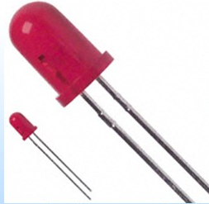
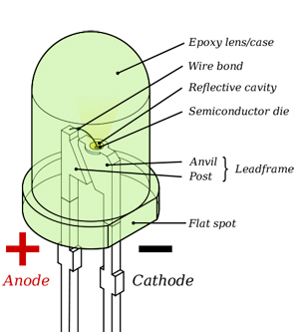
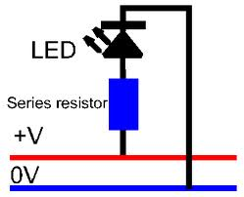
myQuad Kit - LED
MyKit contains a Light Emitting Diode.
LED– is semiconductor light source.
Used as indicator lamps in many devices.
When an LED is forward-biased (switched on), electrons are able to recombine with electron holes within the device, releasing energy in the form of photons.
Notes:
The next component in your kit is an LED. Need to mention that these elements have gotten very popular as their effieciency has increased. They are common sources of light in the home.

Slide 9

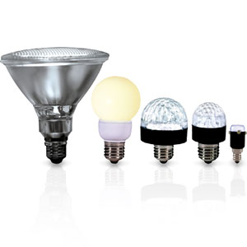
MyKit - LED
LEDs are also used for home lighting needs.
LEDs present many advantages over incandescent light sources including lower energy consumption, longer lifetime, smaller size and faster switching.
Choose ENERGY STAR Qualified LED Lighting to get reduced energy, maintenance, and cooling costs.
Notes:
So, understanding some basic ideas about LEDs might be useful in everyday life.

Slide 10
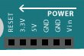
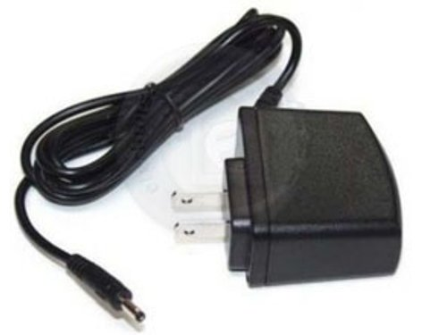
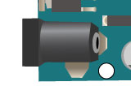
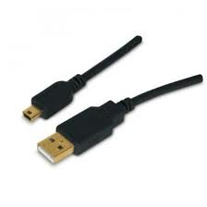
Power
A power source is needed for the Arduino. There are several methods used to “power up” the board.
USB port – can be used to provide power to the board.
External AC adapter
(9 Volts recommended, 2.1 mm barrel tip, center positive)
Notes:
We also need to provide power to the Arduino board. There are several ways to do this.
The black USB cable is included in your kit. There is no AC adapter. You could buy one if you wanted to do a project at home.

Slide 11
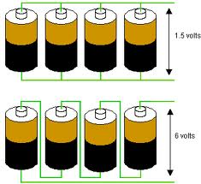
Power
Battery
Voltages of 3, 6, and 9 volts are common because a single alkaline cell is 1.5 V.
Batteries can be connected in “series” to create higher voltage values, or in “parallel” to provide higher currents.
A voltage regulator on the Arduino board is used to limit the voltage to a value used by the integrated circuits or chips.
[Usually, this is 5 volts, a standard value used in early chips (such as TTL)].
Notes:
This is a practical application that uses a little bit of electrical engineering theory in series and parallel circuits.
In parallel circuits, the electrical pathways “add” current together and the resistance of the combined circuit decreases (remember Ohm’s law).
In series circuits, the electrical path “adds” the voltages together. The current through the combined batteries is the same.
The voltage regulator on the board will handle between 7V and 12V of direct current.

Slide 12

Questions?

Slide 13
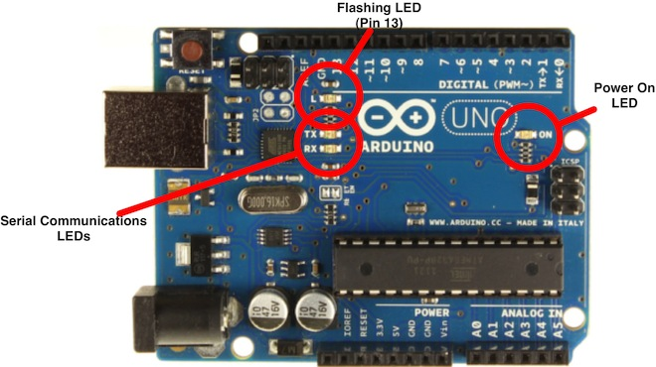
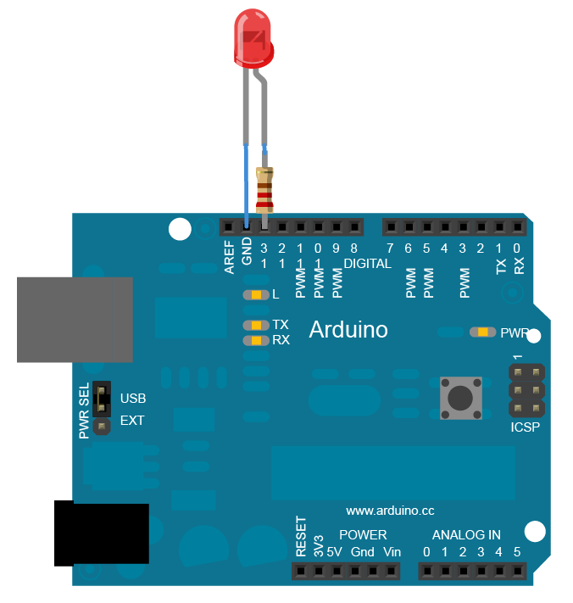
Project 1
LED Blinking Light
Follow the instructions for Project 1 to power on your Arduino and download the software.
Connect up an LED circuit to an external port and get the external LED to blink.
Notes:
We will be learning more about the Arduino IDE and software later on. For now, just try to get familiar with the basic setup.
The details are provided in the Project 1 file and are copied from a web page on the Arduino website.
If there is problems with connecting up the USB cable (unknown Hardware Device or driver not found), there’s an online tutorial on how to “fix” this in the reference list document.

Slide 14
Project 1
LED Blinking Light
Congratulations!
You’ve now completed your first project and learned a lot about the Arduino!

Slide 15
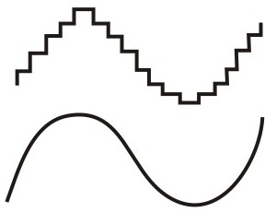
Signals - Analog and Digital
An analog (or analogue) signal is continuously variable, as opposed to having a limited number of steps along its range.
A digital signal has discrete values.
Notes:
The two signals show a waveform with “discrete” values versus a waveform with “continuous” values.
This waveform is NOT binary (unless it’s been encoded and displayed as several binary digits). There are 8 different digital values shown from the “highest” to the “lowest” and so could easily be encoded into 3 binary signals.

Slide 16
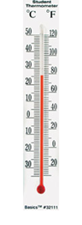
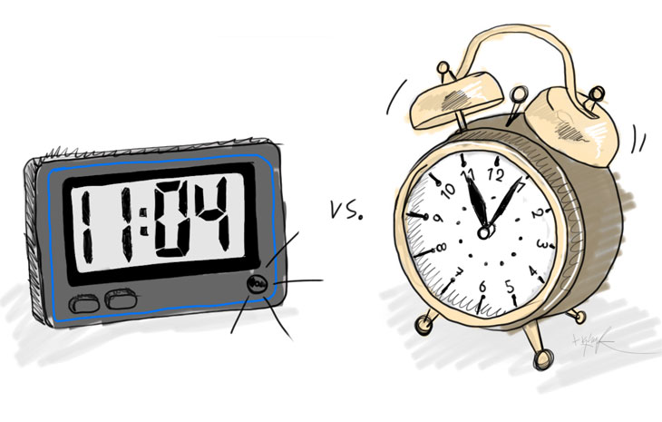
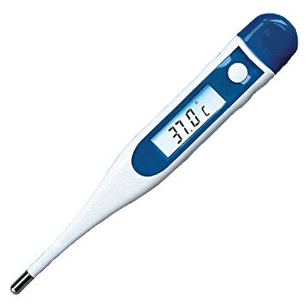
Signals - Analog and Digital
Some everyday examples demonstrating the difference between analog and digital.
In a binary system, used in computing, these values are “0” and “1”.
Several “digits” are needed to represent the value on a single analog signal.
Notes:
Many students may not be familiar with analog clocks. They grew up with digital clocks and may not be able to easily read the time.
So, the thermometer example may work better for some students.
The digital clock takes 2 decimal digits to represent the value on the hour hand of the clock.
You might also have a digital thermometer. The heater “on” when the temperature drops to the “low” level and turns “off” when it raises to a “high” level. So, the digital thermometer just checks for a “low” or “high” position.
An analog thermometer might check the current temperature and use an algorithm to determine that the temperature is below the optimum value and turn on the heat during non-peak hours.
Some early computers were “analog”. The benefits of digital computers have to do with transferring and storing data accurately. Digital signals provide greater “noise immunity”. The difference between a “0” value and “1” value is selected to prevent noise from interfering with the correct “digital value” of the data. Analog values do not provide this noise immunity.

Slide 17
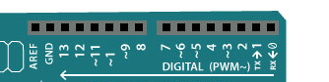
Digital Pins
Digital pins are much easy to understand as there are only two state, either ON or OFF state. In Arduino sketch terms, a ON state is known as HIGH (5V) and OFF state is known as LOW (0V).
You can use these digital pins either as input or output pins. Use the function pinMode() to configure the pins either to INPUT or OUTPUT. The default mode is INPUT if you do not specify them using pinMode().
When you set a digital pin as HIGH, you send a +5V to the pin and when you set the digital pin as LOW, the pins is pulled down to 0V.
You can verify this with a multimeter (red probe to the pin to be tested, black probe to the ground) or put a LED and resistor between the pin and the ground pin.

Slide 18
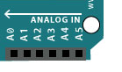
Analog Pins
A signal is continuously variable, as opposed to having a limited number of steps along its range.
The Arduino UNO has 6 analog pins labeled as Analog 0 to 5.
The analog pins are mostly used to read analog sensors and sent to the 6 channels Analog Digital Converter (ADC).
The ADC will convert the voltage (0V to 5V) to integers from 0 to 1023 (10 bit resolution) using the analogRead() function.

Slide 19
Analog Pins
If the analog sensors have a narrow voltage range, you can use the analogReference() to change the input range and resolution.
The analogReference() can be changed from the default analog reference of 5V (or 3.3V for some boards ) to either an INTERNAL analog reference or EXTERNAL analog reference.
The Internal analog reference uses the internal 1.1V when converting from voltage of integer of 0 - 1023.
The External analog reference uses the external AREF pin and takes the voltage on that pin as the reference.
NOTE: If the AREF (Analog Reference) pin is connected, the Arduino will USE the external reference voltage even if you issue the analogReference(INTERNAL); command.

Slide 20
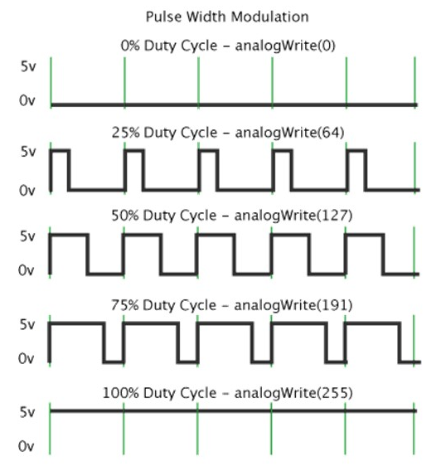
PWM – pulse width modulation
Pulse Width Modulation, or PWM, is a technique for getting analog results with digital means.
Digital control is used to create a square wave, a signal switched between on and off.
The duration of "on time" is called the pulse width. To get varying analog values, you change, or modulate, that pulse width.
If you repeat this on-off pattern fast enough with an LED for example, the result is as if the signal is a steady voltage between 0 and 5v controlling the brightness of the LED.
The ATmega328P chip has three PWM timers, controlling 6 PWM outputs.
Notes:
PWM can minimize power usage. The human eye can only register changes up to a certain frequency.
Your HDTV uses this technique to give you the impression that the video you are watching is “continuous” when actually the pixels may be changing or re-freshed so that they are active for only a very short time.

Slide 21
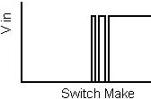
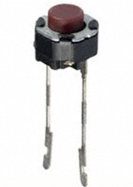
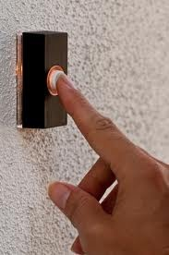
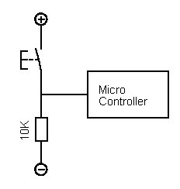
myQuad Kit - Switch
myQuad Kit contains a switch.
Switch – in electrical terms – is an electrical component that can break an electrical circuit.
The current flow is interrupted or diverted from one conductor to another.
The everyday example is a “doorbell” you use in your house.
SPST – Single Pole, Single Throw – is a simple on-off switch. The two terminals are either connected together or disconnected.
We will use this to “switch on/off” connections to the Arduino.
Just like a doorbell button!

Slide 22
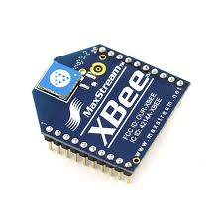
Shields
Shields are boards that can be plugged on top of the Arduino PCB extending its capabilities. The different shields follow the same philosophy as the original toolkit: they are easy to mount, and cheap to produce.
Example – Xbee Shield
The Arduino Xbee shield allows multiple Arduino boards to communicate wirelessly over distances up to 100 feet (indoors) or 300 feet (outdoors) using the Maxstream Xbee Zigbee module.
The myQuad Kit contains one of these Xbee shields!

Slide 23
References and Videos!!
There’s a LOT of references used for the myQuad presentations and projects. The list is included in the document myQuadReferences.
This also includes a number of youtube videos and other resources available for inquiring minds!
Hardware Basics – Arduino

Slide 24
Questions?

Slide 25
Project 2
Digital Serial Read (using a Switch)
Follow the instructions for Project 2 to connect up a pushbutton switch, code some software using the Arduino IDE and test your system.
Notes:
We will be learning more about the Arduino IDE and software later on. For now, just try to get familiar with the basic setup.

Slide 26
Project 2
Digital Serial Read (using a Switch)
Congratulations!
You’ve now completed your second project and learned a lot about using a microcontroller and coding software!

Slide 27


Slide 28
Backup

Slide 29
Installing Software
Lots of online tutorials.
Windows
http://arduino.cc/en/Guide/Windows
Mac OS X
http://arduino.cc/hu/Guide/MacOSX
Linux
http://www.arduino.cc/playground/Learning/Linux
•ArchLinux
•Debian
•Fedora
•Gentoo
•openSUSE
•Puppy
•Pussy
•Slackware
•Ubuntu
•Xandros (Debian derivative) on Asus Eee PC
•All, "the hard way"
http://www.wikihow.com/Write-Arduino-Software-in-C

